Slide 1
Benchmarking the User Experience
Sample Data
Jeff Sauro, PhD

Slide 2
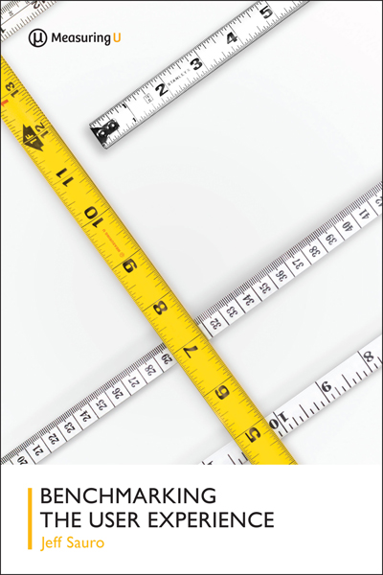
Study Overview
STUDY DESIGN
SAMPLE SIZE
DATES OF STUDY
Online Unmoderated Usability Test
76 Participants
Mix of :Gender, Education, Income, Age
Aug 14 - 15, 2017

Slide 3
Unmoderated Study Methodology
PARTICIPANTS
Randomly assigned to complete tasks on one of two websites [Between Subjects].
TASKS
Search Imagine you’re scheduling a trip to Denver, Colorado and need to book a hotel for your stay. On the following website, find out how much it would cost to book a room (without fees or tax) with one king bed from November 27th – November 29th at the Denver Marriott City Center (use 'MEMBER RATE' pricing).
Browse
Imagine you’re booking one hotel room for a trip to Salt Lake City, Utah on October 15th to October 17th. On the following website, find a hotel in Salt Lake City, Utah that is pet friendly, has a pool, and has a user rating of at least 4.7 out of 5.

Slide 4
Completion Rates
Best Western had a higher completion rate on the Browse task (p = .01)
Notes:
Comp rate for task 1 not significantly different: p=.25
Use statsUsability calc – 2 Comp Rates

Slide 5
Single Ease Question (SEQ)
How easy or difficult was the task?
99% percentile
83% percentile
40% percentile
30% percentile
SEQ scores did not significantly differ between hotels across tasks (p = .12 for browse)

Slide 6
Task Success Time
Median time spent on task by participants who successfully completed the task did not significantly differ between hotels.
Notes:
Search p =.85
Browse p =.11

Slide 7
Task Confidence
How confident are you that you completed the task successfully?
Extremely confident
Not at all confident
Confidence ratings did not significantly differ between hotels.
Notes:
Search p=.41
Browse p=.55

Slide 8
Single Usability Metric (SUM)
SUM is calculated by taking the average of completion rates, task level ease, and completion time
SUM scores did not significantly differ between hotels across tasks.

Slide 9
SUPRQ – Standardized UX Percentile Rank Questionnaire
Usability
files an invoice
locates the correct product SKU
adds a contact to a database
Trust, Value, and Comfort
The information on the websites is credible
The information on the website is trustworthy
Loyalty
I will likely return to the website
NPS (How likely are you to recommend this website to a colleague or friend)
Appearance
This website has a clean and simple presentation
I find the website attractive

Slide 10
SUPR-Q – Standardized UX Percentile Rank Questionnaire
Overall SUPR-Q scores did not significantly differ between hotels.
Notes:
Overall SUPRQ raw scores not significantly different: p=.71

Slide 11
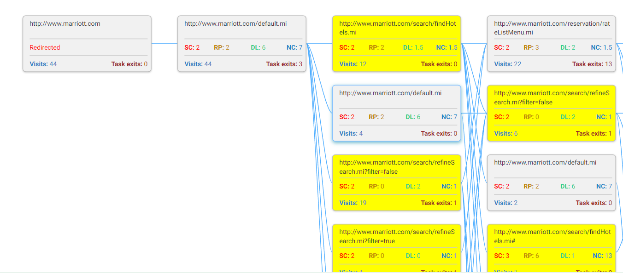
Diagnostics on Marriott
Non-Clickable

Slide 12
SEQ Verbatim Responses: Search
Please describe why you rated the difficulty the way you did
“Finding the room was easy, but finding member rates was unnecessarily difficult.”
“I was looking at the rate for just one night not all three nights.”
“It was a little difficult to figure out which hotel was at the city center.”
“The member rate was not clear. Also, there are multiple room types for the king room, which added confusion.”
“The website was too busy so it was hard to focus and determine the actual rate. Also, the website did not present all available options, e.g., "flexible rate," until after performing the initial search.”
“I didn't see how to get the 1 King bed option. I looked around but I might have missed it.”
“The interface was as easy to use as before but it didn't show the total price for three days so I had to do the math by my own.”
“I am not sure if I saw the per night rate or the rate for all three nights.”

Slide 13
SEQ Verbatim Responses: Browse
Please describe why you rated the difficulty the way you did
“I had to use the sidebar to find a hotel with a pool that was also pet friendly. They weren't listed together under any hotel in the search bar.”
“I'm used to navigation being on the left, but it wasn't difficult to find the boxes to refine the search.”
“I had a hard time selecting the dates that I wanted to search for.”
“I didn't think the website was user friendly at all. I'm pretty good at finding information on the internet and I had a difficult time finding exactly what I needed. I could see someone, like my parents, having an incredibly difficult time with that site. That site is 10 years out of date.”
“It was easy to use. All I had to do was enter my information and click on the amenities I wanted.”
“The filtering was odd but easy.”
“The website was simple and easy to use. I loved the interface because after I added the dates and location I was quickly, with two clicks, able to filter the search to only show me hotels that had a pool and were pet friendly. Also right next to the rating was the number of people that rated it. It made the process very streamlined.”

Slide 14
Total Task Time
Median time spent on task did not significantly differ between hotels across tasks.
Notes:
Search p=.48
Browse p=.13

Slide 15
AGE
GENDER
57%
43%
INCOME
EDUCATION

Slide 16
NPS - Net Promoter Scores
NPS = 8%
NPS = 5%
There is no significant difference between the breakdown of promoters, passives, and detractors between Marriott and Best Western.
There is no significant difference between the breakdown of promoters, passives, and detractors between Marriott and Best Western.

Slide 17
Assignment For Next Week
Identify a website to benchmark, think about users, tasks and metrics
Design a benchmark study using the test plan template
DUE 10/17

Slide 18
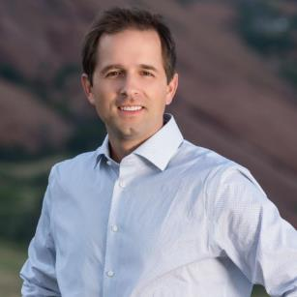
About The Author
Jeff Sauro, PhD is the founding principal of MeasuringU, a UX research firm specializing in moderated and unmoderated UX measurement, including benchmark studies on desktop and mobile. He is a Six-Sigma trained statistical analyst and pioneer in quantifying the user experience. Jeff is the author of five books, including Customer Analytics for Dummies and Quantifying the User Experience. His forthcoming book, Benchmarking the User Experience is scheduled for Summer 2018.
He has published over twenty peer-reviewed research articles and presents tutorials and papers regularly at the leading Human Computer Interaction conferences: CHI, UXPA, HCII and HFES. He has worked for Oracle, PeopleSoft, Intuit and General Electric. He is an adjunct professor at the University of Denver and leads an annual UX Boot Camp focusing on UX Methods and Metrics.
Jeff received his PhD in Research Methods & Statistics at the University of Denver. He received his Master’s in Learning, Design and Technology from Stanford University with a concentration in statistical concepts. Prior to Stanford, he received his B.S. in Information Management & Technology and B.S. in Television, Radio and Film from Syracuse University.

Slide 19
About MeasuringU
MeasuringU is a quantitative research firm based in Denver, Colorado focusing on quantifying the user experience.
Remote UX Testing Platform (Desktop & Mobile)
UX Research
Measurement
& Statistical Analysis
Eye Tracking & Lab Based Testing
MeasuringU.com
@MeasuringU

