Slide 1
Survey Design
Jeff Sauro, PhD
Jim Lewis, PhD

Slide 3
Do Surveys Always Suck?
Source: Erika Hall: On Surveys

Slide 4
When a Survey is a Better Research Method
Identifying your users:
age, gender, purchase frequency, product experience, geography.
Identifying the most important features or content:
Top-task analysis.
Benchmarking attitudes/Creating Standardized Metrics:
Do people trust us, think the experience is usable? Attitudes affect/predict/explain behavior.
Identifying key drivers of a product or experience:
Why do people have low trust, satisfaction?
Finding the likelihood to repurchase or recommend:
Intent is a good predictor of behavior.
Notes:
Source: https://measuringu.com/horrible-responserate/

Slide 5
What makes a good survey?

Slide 6
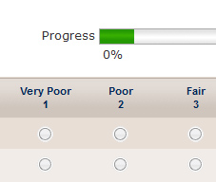
Surveys are artifacts designed for human use
Consider human factors fundamentals
Avoid excessive length
Avoid unfamiliar terms
Write clearly
Use appropriate types of items
Design for all platforms respondents might use
Don’t forget usability and pilot testing
Notes:
Source https://measuringu.com/survey-tips/

Slide 7
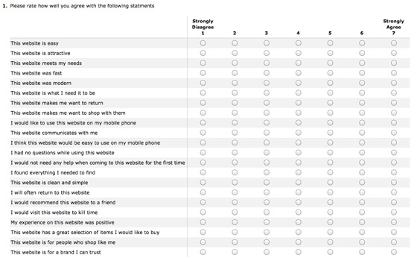
Ways to get a terrible response rate
Make it feel like a test – lots of open-ended items
Impossible screener
Giant matrices
No sense of progress
Ask the really personal questions first
Ask irrelevant questions without an N/A option
Don’t think about respondent incentives
Notes:
Source: https://measuringu.com/horrible-responserate/

Slide 8
Writing survey questions

Slide 9
Good research questions for surveys
How many?
Demographics
Attitudes
Perceptions
Expectations
Notes:
https://measuringu.com/survey-tips/

Slide 10
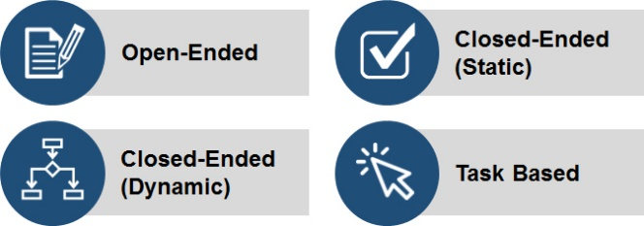
Classes of survey questions
Open-ended:
Coded into variables
Close-ended (static):
Multiple choice, ratings
– always same response options
Close-ended (dynamic):
Adaptive conjoint, MaxDiff, item response theory
– items or response options differ depending on previous responses
Task based:
Unmoderated usability study
Notes:
https://measuringu.com/survey-question-classes/

Slide 11
What not to include in a survey
Overall, how satisfied are you with the cost and quality of the product?
Double-barreled – what is rated?
Don’t you agree that employers should be required to give paid time off?
Leading
Age range: 10-20; 20-30; 30-40; 40-50; 60+
Incomplete list of options, overlapping ranges

Slide 12
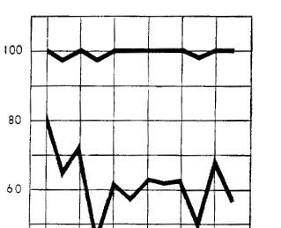
Identifying potential bias
Social desirability and conformity
Yea saying and acquiescence
Order effects
Prestige
Threat and hostility
Sponsorship
Stereotype
Notes:
Source https://measuringu.com/survey-biases/

Slide 13
Types of Questions/Items
Notes:
https://measuringu.com/rating-scales/

Slide 14
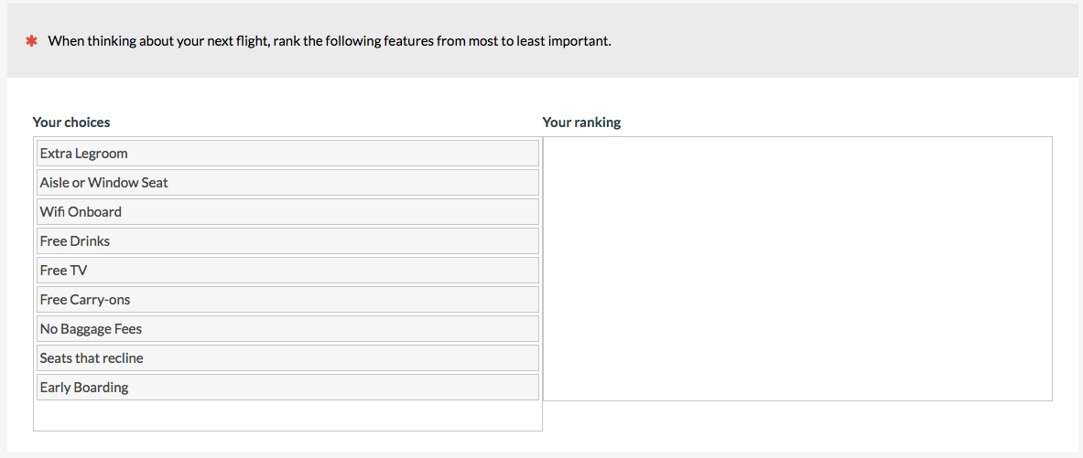
Multiple choice vs forced choice
Notes:
https://measuringu.com/rating-scales/

Slide 15
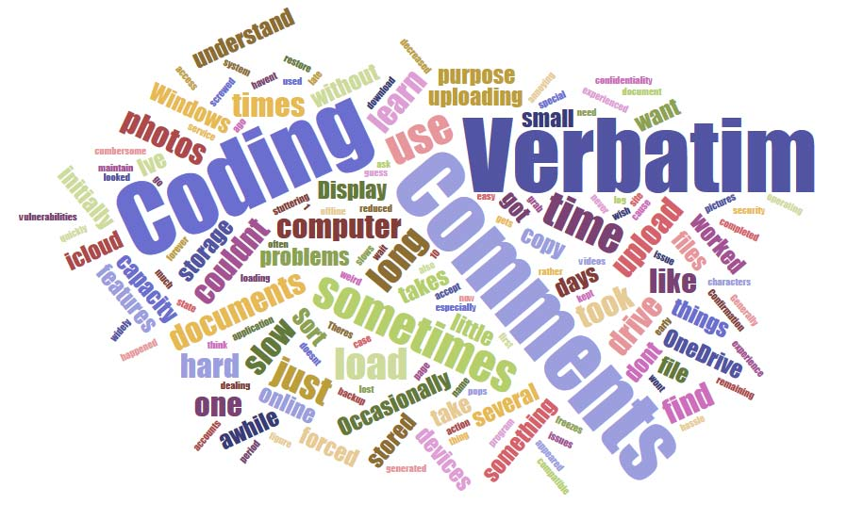
Open-ended responses
Avoids limitations of closed-ended items
No substitute for reading content
Quantify using manual coding/classification
Current automation inadequate
To code and classify:
Sort and clean
Group into themes
Split and combine as needed

Slide 16
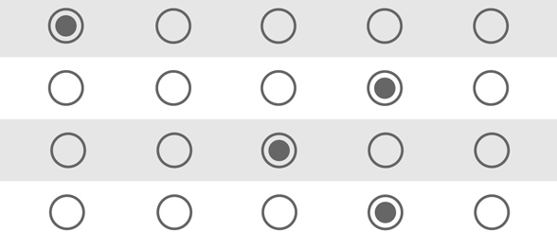
Grids and matrices
Faster to complete than individual items
More straightlining and nonresponse
Little effect on scores and distributions
May be some effect on correlation and loading
Respondents dislike large grids but actually prefer smaller ones
Notes:
https://measuringu.com/grids-responses/

Slide 17
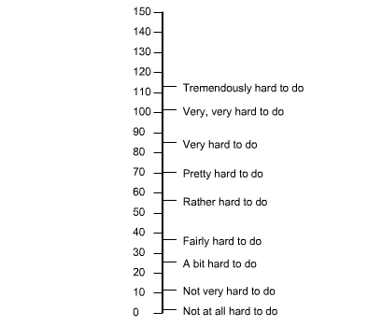
Rating scales: Standardization > format issues
Number of points: More than 3, usually 5-7, 11
Labels and anchors: Little effect on responses using common formats (1-7, 0-10)
Neutral point: Provide unless strong reason
Positive/negative wording: Prefer positive
Survey items in grids vs alone: Avoid large grids
Sauro corollary to Parkinson’s law of triviality

Slide 18
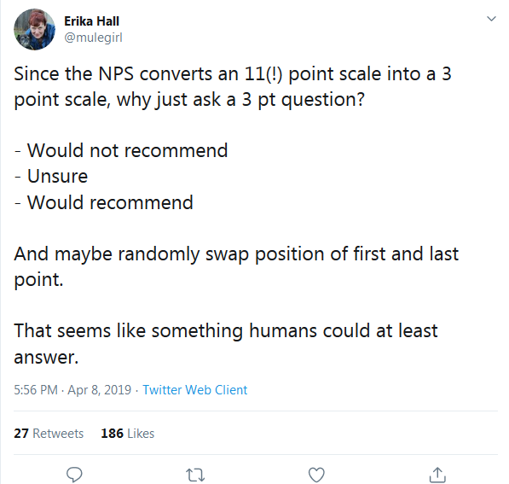
3 Point scale superiority is a myth.
“Thumbs up, thumbs down is simple. 3-point scales are simple. If you feel strongly about a 4 or 5-point scale, go for it. Not more. If you measure very specific experiences, it is very easy for a user to decide if they are happy or not.” Tomer Sharon
More scale points increase reliability (3 are unreliable)
There’s a loss of intensity and validity with three-point scales
See: Is a Three-Point Scale Good Enough?
Notes:
https://measuringu.com/three-points/
https://measuringu.com/coloring-responses/
https://measuringu.com/3-point-nps/

Slide 19
Survey Setup

Slide 20
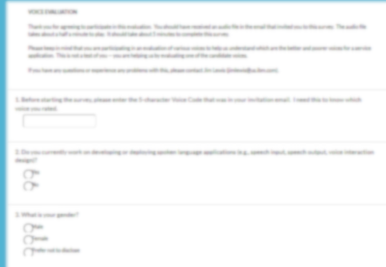
Introduction page
Include title of survey
Thanks for agreeing to participate
Estimated completion time
Purpose of survey
Not a test of you – you’re helping us
Contact info in case there’s a problem
Collect any data needed to continue

Slide 21
Formatting
Include progress bar (if possible)
Limit number of questions per page
One-per-page can increase completion time
Biggest drop-out factor is length

Slide 22
More formatting
Counterbalancing/randomization:
Apply to response options, items, and tasks when appropriate
Use of bolding:
Don’t overuse, but consider bolding key instructions so they stand out from the rest of the text
Color and backgrounds:
Be legible and be consistent, and for periodic surveys it will be easier to be consistent if you avoid using nonstandard colors or backgrounds

Slide 23
Best practices in length of survey
Best predictor of abandonment is length
Acceptable length depends on delivery method
Shortest for intercept surveys
Longer for email surveys
Median time for MeasuringU surveys ~5 min
Multiple short surveys usually better than one long one

Slide 24
Data Analysis

Slide 25
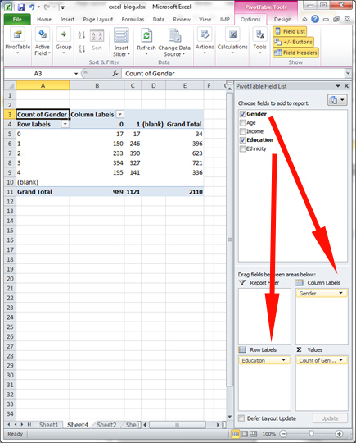
Creating pivot tables
Powerful tools for exploring data
Easy way to set up cross tabulation
Click Pivot Table on Excel ribbon
Select columns that contain the data
Labels at top, no spaces
Drag/drop desired row/column labels
Modify operations if desired (average, sum)
Notes:
Source https://measuringu.com/excel-2/

Slide 26
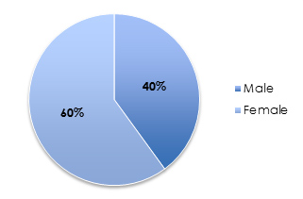
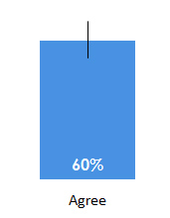
Displaying and summarizing survey data
Binary responses:
pie, USA Today, bars with CI

Slide 27
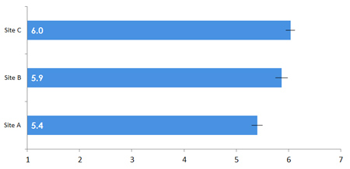
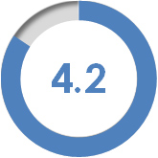
Displaying and summarizing survey data
Rating scales:
mean, top box, net, bars with CI

Slide 28
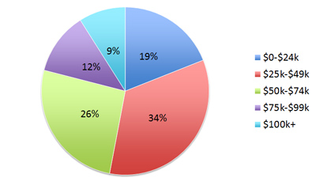
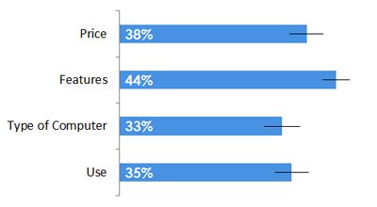
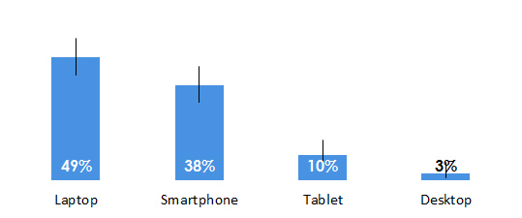
Displaying and summarizing survey data
Single select:
pie, bars with CI
Multiple select:
bars with CI

Slide 29
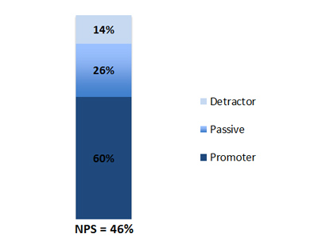
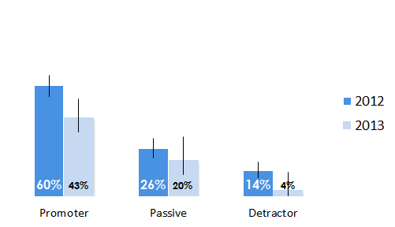
Displaying and summarizing survey data
Likelihood-to-recommend:
mean, top box, net, bars with CI

Slide 30
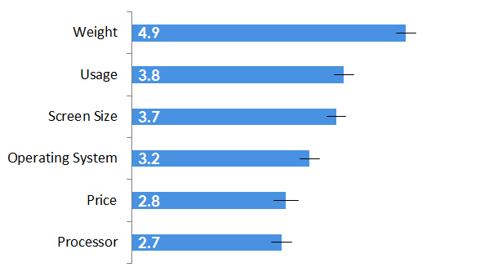
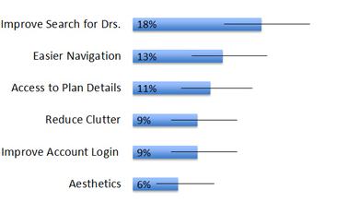
Displaying and summarizing survey data
Forced rank:
mean, CI
Open-ended:
categorize, bars with CI

Slide 31
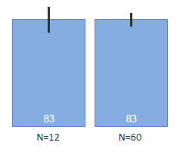
Using confidence intervals
CI show precision and location
3 ingredients: confidence level, variability, n
Produce plausible range given data in hand
Intervals wider with higher confidence
Intervals wider with higher variability
Intervals narrower with higher n
Different methods for means and percentages

Slide 32
Analyzing preference data
Binomial test with confidence interval
Chi-square goodness of fit test
Comparison of binomial confidence intervals
McNemar exact test
Rank tests (Friedman, Kruskal-Wallis)
Notes:
Source https://measuringu.com/preference-data/

Slide 33
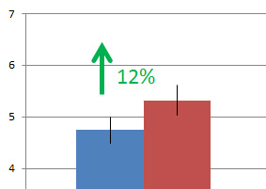
Understanding brand lift and drag
A way to understand how particular experiences impact attitudes
Comparison of pre and post ratings
Lift can be positive or negative
When negative, also known as “drag”
Notes:
Source https://measuringu.com/measuring-lift/

Slide 34
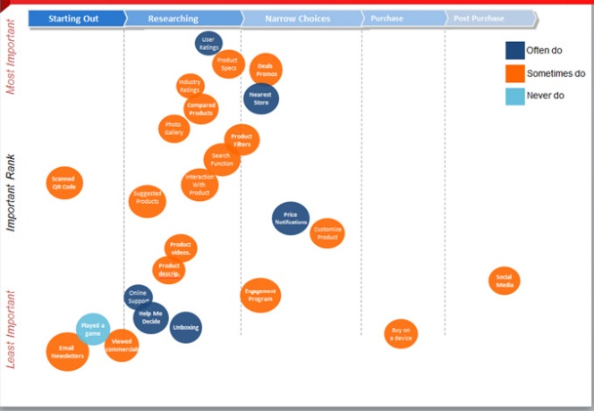
Examining variables – cross tabbing
Process of examining more than one variable in the same table or chart (“crossing” them)
Used to identify interesting clusters
Commonly done with observed variables to illustrate group similarities and differences
Can be part of the analysis of open-ended responses after classification

Slide 35
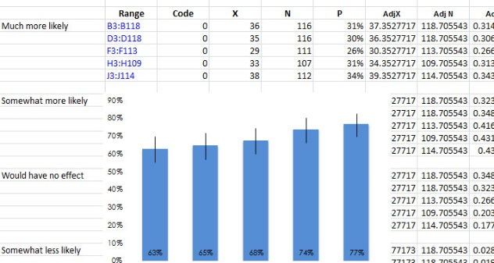
Collapsing variables
Collapsing can simplify research questions
Convert multiple frequency options into Low/High
Convert multiple loyalty membership options into Member/Nonmember
Convert 11-point scale to 3 categories (NPS)
More advanced: principal components and factor analysis to combine multiple items into a single score

Slide 36
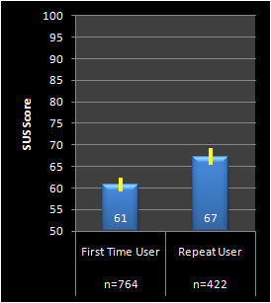
Controlling for prior experience
Prior use tends to lift measures of perceived usability (replicated numerous times)
With three categories of years of experience (<3, 4-5, >5) each level had 5% higher SUS
Important to track prior experience
Rule of thumb – if can’t control for prior experience, use a 6-15% score adjustment
More advanced: Analysis of covariance

Slide 37
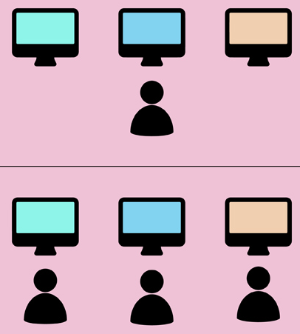
When to use between- vs within-subjects designs
Factor to Consider | Between | Within
Sample Size & Power | - | ▼
Carryover Effects | ▼ | -
Impact on Attitudes | ▼ | -
Comparative Judgment | - | ▼
Study Duration | ▼ | -
Compromise – all participants get baseline design with one alternate

Slide 38
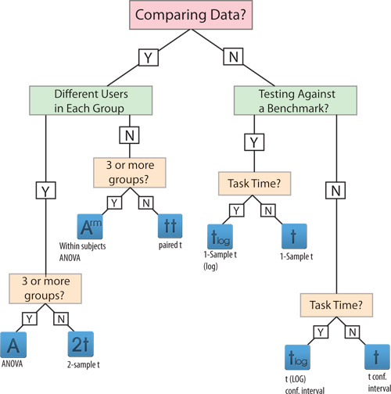
Conducting statistical tests and interpreting p
Many different statistical tests
Appropriateness depends on type of data and question being asked
All produce a value for p
The decision regarding statistical significance is binary and depends on whether the p-value is greater or lower than a criterion
Most common criterion is p < .05

Slide 39
Hypothesis testing errors
REALITY
Is a Difference
No Difference
Guilty
Innocent
False Positive
Difference!!
Convict
TYPE I Error
Alpha = .05
YOUR DECISION
False Negative
No Difference!
Acquit
TYPE II ERROR
Beta= .20

Slide 40
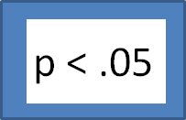
What does statistically significant mean?
Probably not due to chance
Probability of getting this or a more extreme result if there really is no difference
Sampling error = never absolutely certain
Most exact way of saying maybe
Setting p to .05 is a scientific convention, not necessarily best criterion in industrial studies
Best practice to compute CI around differences to show plausible range – moves from just statistical to practical significance

Slide 41
Review of Advanced Survey Analyses

Slide 42
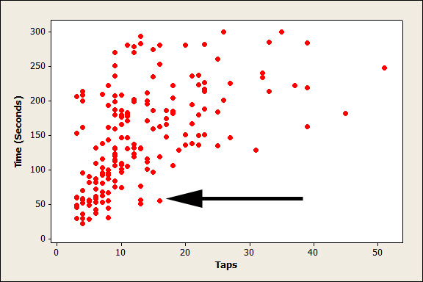
Understanding Correlations
Notes:
More Information See https://measuringu.com/predicting-r/

Slide 43
Interpreting Correlations
Description | Correlation
Aspirin and reduced risk of heart attack | 0.02
Ever Smoking and Lung Cancer after 25 years | 0.08
College Grades and Job Performance | 0.16
Years of Experience & Job Performance | 0.18
SAT Scores and Cumulative GPA at University of Pennsylvania for (White & Asian Students) | 0.20
HS Class Rank and Cumulative GPA at University of Pennsylvania for (White & Asian Students) | 0.26
Psychotherapy and Subsequent Well Being | 0.32
Raw Net Promoter Scores and Future Firm Revenue Growth in 14 Industries | 0.35
GRE Quantitative Reasoning and MBA GPA | 0.37
Unstructured Job Interviews and Job Performance | 0.38
Viagra and improved sexual functioning | 0.38
Height and Weight from 639 Bangladeshi Students (Average of Men and Women) | 0.38
Past Behavior as Predictor of Future Behavior | 0.39
% of Adult Population that Smokes and Life Expectancy in Developing Countries | 0.40
College Entrance Exam and College GPA in Yemen | 0.41
SAT Scores and Cumulative GPA from Dartmouth Students | 0.43
Height and Weight in US from 16,948 participants | 0.44
NPS Ranks and Future Firm Revenue Growth in 14 Industries | 0.44
Rorschach PRS scores and subsequent psychotherapy outcome | 0.44
Description | Correlation
Intention to use technology and actual usage | 0.50
General Mental Ability and Job Performance | 0.51
Purchase Intention and Purchasing Meta Analysis (60 Studies) | 0.53
Work Sample and Job Performance | 0.54
PURE Scores From Expert and SUPR-Q Scores from Users | 0.55
PURE Scores From Expert and SEQ Scores from Users | 0.67
Likelihood to Recommend and Recommend Rate (Recent Recommendation) | 0.69
SUS Scores and Future Software Revenue Growth (Selected Products) | 0.74
Purchase Intent and Purchase Rate for New Products (n=18) | 0.75
SUPR-Q quintiles and 90 Day purchase rates | 0.78
Likelihood to Recommend and Recommend Rate (Recent Purchase) | 0.79
PURE Scores From Expert and Task Time Scores from Users | 0.88
Accuracy of Pulse Oximeter and Oxygen Saturation | 0.89
Likelihood to Recommend and Reported Recommend Rate (Brands) | 0.90
r = .10 small r = .30 medium r = .50 large
Context Matters Most

Slide 44
5 Advanced Stats Techniques & When to Use Them
Technique | Focus | Research Example | Gotcha
Regression Analysis | Best combination of variables to predict continuous outcome variables | What features best predict likelihood to recommend? | Correlated independent variables and linearity
ANOVA | Comparison of multiple variables plus interactions | How does device type and form type affect task completion time? | Alpha inflation
Factor Analysis | Identify latent variables that form groups (factors) | What combination of items describes the constructs of appearance and trust? | Subjective factors & linearity
Cluster Analysis | Uncover how items form latent groups | Do users group two products together? | Subjective clusters
Logistic Regression | Best combination of variables to predict discrete outcome variables | How much does a service experience and tenure affect purchase rates? | Correlated independent variables and linearity
Notes:
Source https://measuringu.com/advanced-stats/

Slide 45
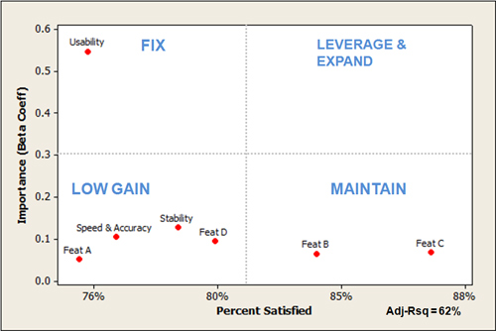
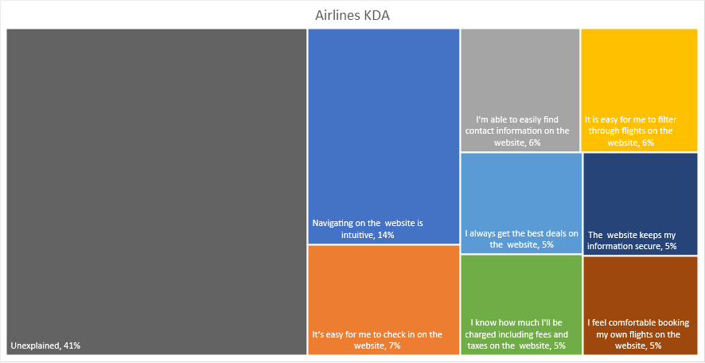
Regression/Key driver analysis
Relative importance of predictors on outcomes
Based on output from multiple linear regression
Importance derived from standard beta weights
Two key visualizations
2x2 matrix based on impact and intensity
Rectangle chart of percentage explained variability

Slide 46
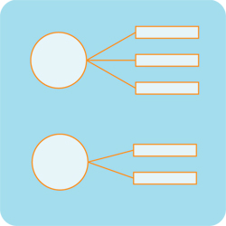
Factor analysis
Variety of methods for identifying latent structure in data
Takes many observed variables and shows alignment of observed variables with factors
Some subjectivity involved in determining number of factors
Commonly used for development of standardized questionnaires
Quantitative basis for combination of item ratings into scale scores
Notes:
https://measuringu.com/key-drivers/

Slide 47
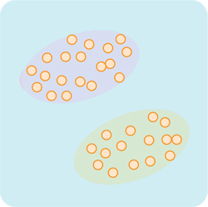
Cluster analysis
Variety of methods for identifying groups of items
Groups inferred from data
Some subjectivity involved in determining number of clusters
Commonly used for research in segmentation and personas

Slide 48
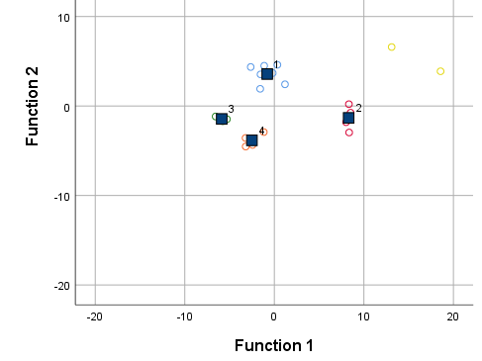
Discriminant analysis
Commonly used classification method
Identify groups using cluster/class analysis
Train classification model using demographic and rating variables
Use classification model to make typing tool
Use typing tool to predict segment membership

Slide 49
Personas

Slide 50
1. Conduct qualitative interviews and observation
Notes:
Through careful observation and inquiry, identify challenges, problems, attitudes, and behaviors that characterize and differentiate groups of users. The number of participants you interview and observe is a function of how common the behaviors and attitudes you observe are. Here is a primer on conducting qualitative research. For the grocery study, the team had already conducted extensive interviews and observations and synthesized the findings into four personas they wanted to validate.

Slide 51
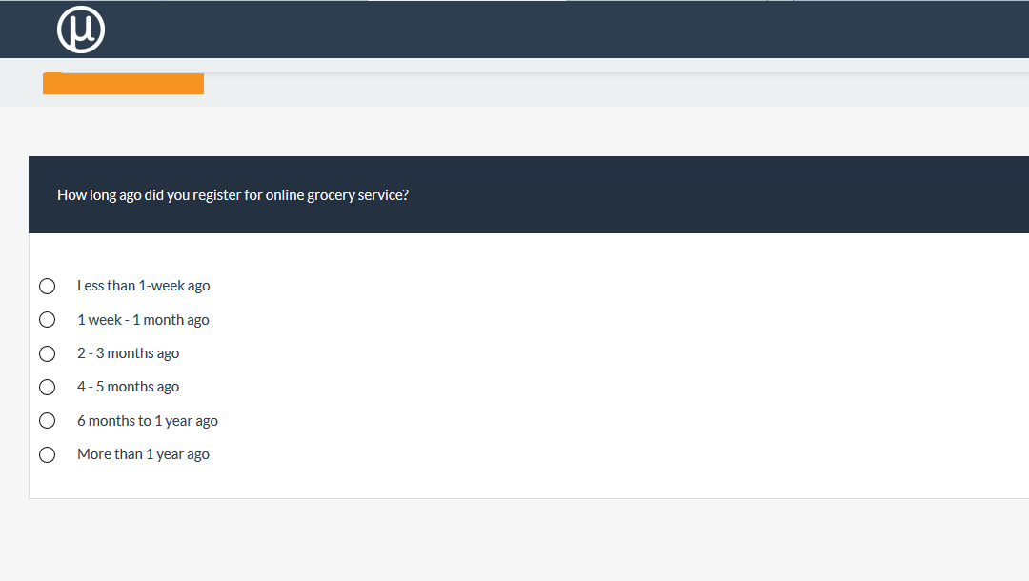
2. Survey a large sample of users or prospects

Slide 52
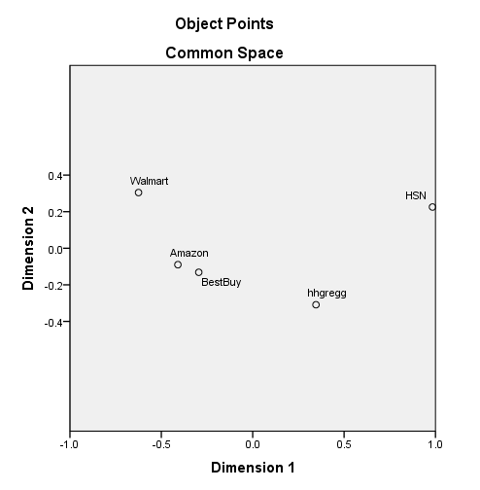
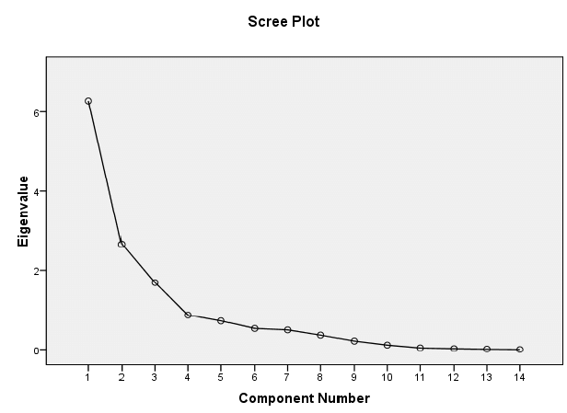
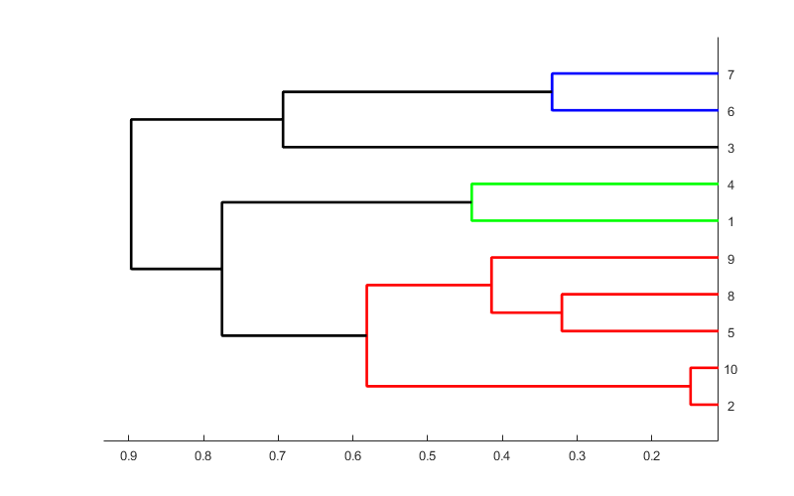
3. Identify the segments

Slide 53
4. Determine key variables that differentiate segments
It’s a difficult to find time
39%
77%
85%
92%
100%
0
I enjoy grocery shopping
10%
43%
76%
78%
100%
0
I like to try new interesting items
37%
55%
73%
93%
100%
0

Slide 54
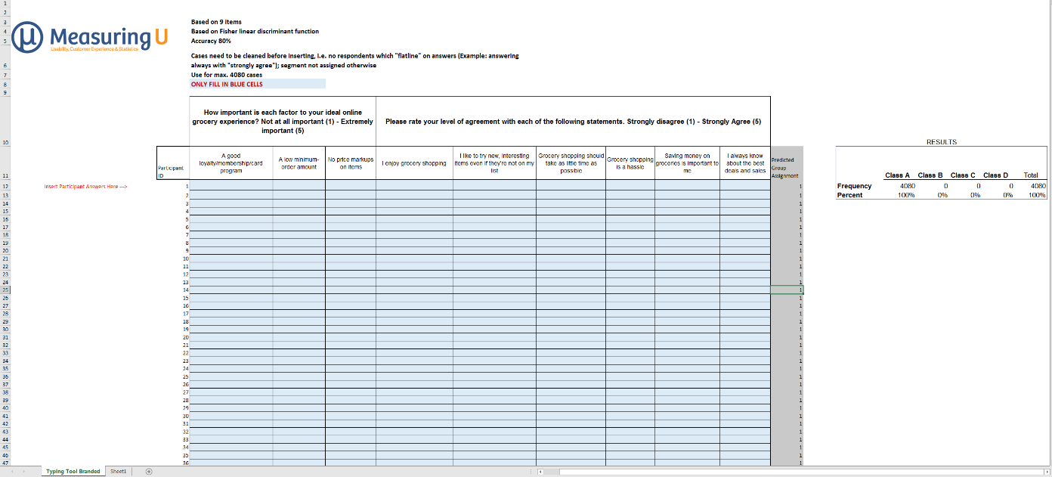
5. Predict segment membership using a typing tool
Notes:
Using multiple

Slide 55
6. Personify or qualify your segments
Personify
Go deep to get insights.
Conduct qualitative interviews & observations.
Qualify
What variables matter?
What percent of the population?

Slide 56
Scenarios of Interest

Slide 57
Persona identification and classification
Quantitative cluster and classification requires large sample sizes to build precise models
That said, you can do some quantitative work with small samples, keeping in mind this limits what you can claim
Early trends often continue with collection of more data … except when they don’t
With that in mind, here are some VERY preliminary results from the data you provided

Slide 58
Data reduction of ratings – PCA
 | Component
 | 1 | 2 | 3 | 4
1. Anx2Rel | -0.118 | -0.538 | 0.045 | -0.286
2. Spon2Plan | 0.477 | 0.503 | -0.411 | 0.481
3. Lux2Budg | 0.892 | -0.050 | -0.170 | 0.193
4. Comf2Barg | 0.882 | 0.207 | 0.052 | -0.055
5. Money2Time | 0.847 | 0.000 | 0.021 | 0.196
6. Discon2Con | 0.357 | -0.220 | 0.556 | 0.127
7. Exp2Inexp | 0.135 | 0.490 | -0.493 | 0.373
8. Solo2Group | -0.022 | 0.021 | 0.914 | 0.152
9. Thrill2Relax | -0.236 | 0.751 | 0.040 | 0.227
10. Bout2Chain | 0.492 | 0.452 | 0.305 | -0.306
11. Flow2Control | -0.223 | 0.321 | -0.438 | 0.032
12. New2Favorite | 0.036 | 0.717 | -0.331 | -0.092
13. Mem2Photo | 0.056 | -0.164 | 0.219 | 0.821
14. Self2CustSvc | -0.366 | -0.049 | 0.725 | -0.027
15. Intro2Extro | -0.239 | -0.838 | 0.076 | 0.090
16. Prep2Wing | -0.183 | -0.254 | 0.340 | -0.692
17. Preplan2Imm | -0.051 | -0.327 | -0.437 | -0.739
Not clearly aligned – 2, 7, 10
Component 1: 3, 4, 5
Component 2: 1, 9, 12, 15
Component 3: 6, 8, 11, 14
Component 4: 13, 16, 17
Spread of items across components good sign for discrimination/classification
Alignments seem reasonable?

Slide 59
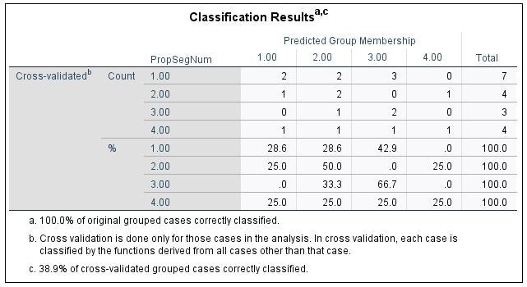
Discriminant analysis – all rating variables
Overall classification accuracy was 38.9%
Not great, but better than chance expectation of 25%
Check diagonal for accuracy within class

Slide 60
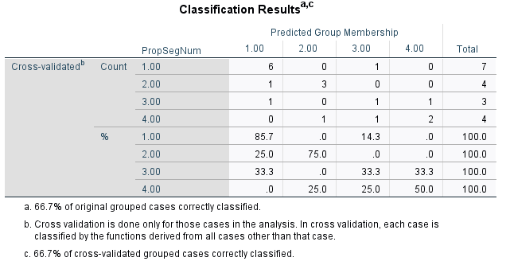
Discriminant analysis – best stepwise model
Stepwise process retained two predictors: 5. Money2Time and 7. Exp2Inexp
Overall classification accuracy was 66.7%
Check diagonal for accuracy within class

Slide 61
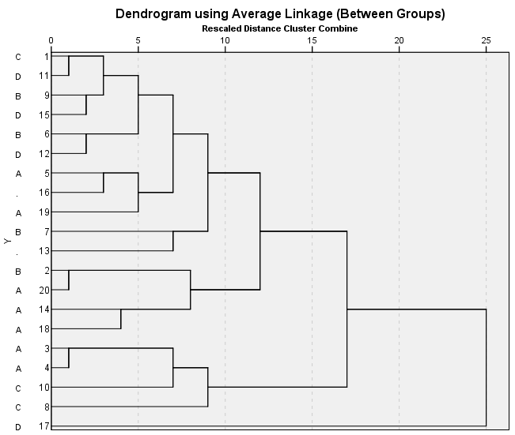
Cluster analysis – all rating variables
Training discriminant analysis depends on correct assignment of participants to groups
Preliminary hierarchical cluster analysis with all rating variables suggests this not the case
You would expect the letters to be more tightly grouped
Use this to discuss revising your preliminary assignments

Slide 62
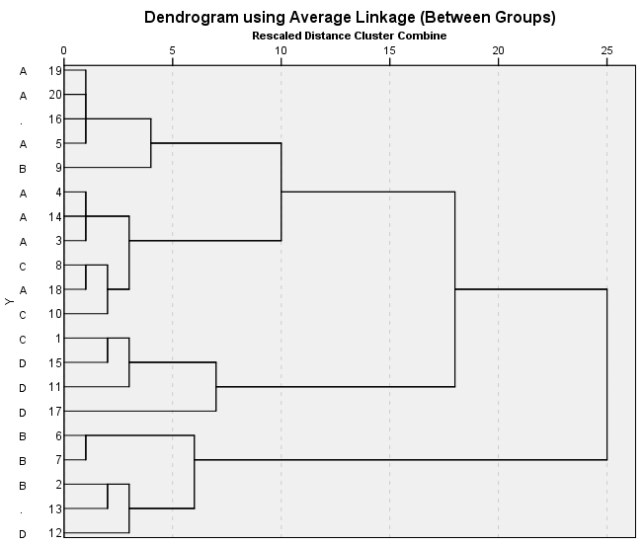
Cluster analysis – best two predictors
Note more consistent grouping of letters in this graph
Consistent with finding from stepwise discriminant analysis
If current assignment of participant to persona is correct, only need two ratings for reasonably accurate prediction
Need more data!

Slide 63
Exploring your UX metrics data
Are the data ready for analysis?
Which categorical variables drive CSAT?
Which UX rating variables drive CSAT?
Is there any latent structure in the ratings?
Recommendations

Slide 64
Data preparation
Created numeric variable for CSAT
(1: Extremely dissatisfied ‒ 5: Extremely satisfied)
Created Group variable for tracking which of six groups the respondent was a member
Deleted thousands of incomplete responses
Check coding of External Consistency
– might be better to reverse it

Slide 65
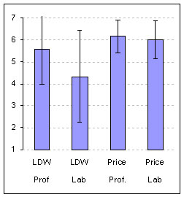
Which categorical variables affect CSAT?
Task - significant
Task completion - significant
Group - not significant
Age range - significant
Membership - significant
Frequency of website use - significant
New/repeat customer - significant
MP status - significant

Slide 66
Which categorical variables affect CSAT?
With large samples expect statistical significance
CSAT stability over groups surprising
CSAT differences for age groups kind of surprising
Not surprising that CSAT was:
Different for different tasks
Higher when task successful
Higher for more frequent users
Higher for loyalty members

Slide 67
Key driver analysis – rectangle
Notes:
Reverse coded External Consistency

Slide 68
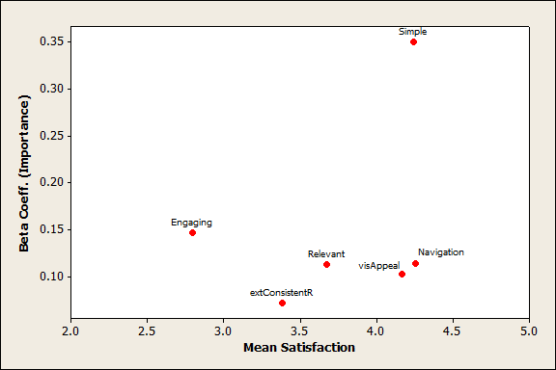
Key driver analysis – 2x2 matrix
FIX
LEVERAGE &
EXPAND
LOW GAIN
MAINTAIN

Slide 69
Is there any latent structure in the ratings?
Rotated Factor Matrixª
 | Factor
 | 1 | 2
Simple | .862 | .289
Navigation | .810 | .238
intConsistent | .492 | .349
extConsistent | -.100 | -.753
Relevant | .429 | -.145
Engaging | .353 | .085
visAppeal | .613 | .187
Extraction Method: Maximum Likelihood. Rotation Method: Varimax with Kaiser Normalization.
a. Rotation converged in 3 iterations.
Parallel analysis indicated two factors
Used MLFA and Varimax rotation
60% of variance explained
All ratings except External Consistency aligned with first factor
Remaining items, based on content, appear to be consistent with latent factor of perceived usability
Reliability of Factor 1 items: α = .75

Slide 70
UX metrics - recommendations
Automate conversion of CSAT verbal responses to numeric (1: worst; 5 : best)
Keep track of survey waves with a variable
Consider reverse coding of External Consistency
Consider collection of 11-point LTR rating
– can’t identify extreme ratings with five-point scale
(> 10,000 respondents rated CSAT = 5)
Consider adding UMUX-LITE to rating battery
Consider temporary collection of SUS to check correspondence with custom global score

Slide 71
Remote UX Testing Platform
(Desktop & Mobile)
UX Research
Measurement
& Statistical Analysis
Eye Tracking &
Lab Based Testing
MeasuringU is a research firm based in Denver, Colorado focusing on quantifying the user experience.
measuringu.com
@MeasuringU

Slide 72
Exercises using “Subset for Exercises” sheet
Confidence Interval Estimation
Between-Subjects t-Test
Within-Subjects t-Test
Correlation
2 Proportion Test
Between-Subjects ANOVA
Within-Subjects ANOVA

Slide 73
CONFIDENCE INTERVAL ESTIMATION
MeasuringU 2020

Slide 74
Confidence Interval Estimation: CSAT
You want to know your overall mean CSAT with 90% confidence.
Copy CSATnum data and paste into statsUsabilityPak - 1 sample t.
What is the plausible range? Is it significantly greater than 4?

Slide 75
T-TESTS
MeasuringU 2020

Slide 76
Between-subjects t-test: Task completion
Is CSAT different for those who complete or fail to complete tasks?
Sort on “Task accomplished?” and paste CSATnum into statsUsabilityPak - 2 sample t.
What is the mean difference? Is it statistically significant? Practically significant?

Slide 77
Between-subjects t-test: New vs repeat visit
Is CSAT different for those who are new versus repeat visitors?
Sort on “NewVSRepeatVisit” and paste CSATnum into statsUsabilityPak - 2 sample t.
What is the mean difference? Is it statistically significant? Practically?

Slide 78
Within-subjects t-test: CSATper vs UXnum
Is there a difference in magnitude between CSAT expressed as a percentage and a custom UX metric based on the previously described factor analysis of the ratings, manipulated like the SUS to produce a 0-100-point measure?
Paste CSATper and UXnum into statsUsabilityPak - Paired t test.
What is the mean difference? Is it statistically significant? Practically?

Slide 79
CORRELATION
MeasuringU 2020

Slide 80
Correlation: CSATper with UXnum
Is there a significant correlation between CSAT expressed as a percentage and the custom UX metric?
Paste CSATper and UXnum into statsUsabilityPak - Regression.
What is the correlation? Is it statistically significant? Practically?

Slide 81
2 PROPORTION TEST
MeasuringU 2020

Slide 82
2 Proportion Test: Booking vs Find Info successes
Is there a difference in reported success completing booking versus looking for information?
Sort on Reason for Visit and Task Accomplished. Determine # successes and totals for both and enter into statsUsabilityPak - 2 comp rates.
What is the difference? Is it statistically significant? Practically?

Slide 83
ANALYSIS OF VARIANCE
MeasuringU 2020

Slide 84
ANOVA: Effect of fare on CSAT (between subjects)
Are there differences in CSAT for different fares in which customers are interested?
Sort by fares of interest and copy CSATnum values into statsUsabilityPak - ANOVA
What are the differences? Statistically significant? Practically?

Slide 85
ANOVA: Compare three ratings (within subjects)
Are there differences in the magnitudes of ratings for Simple, Engaging, and VisAppeal?
Copy Simple, Engaging, and VisAppeal into statsUsabilityPak – RM-ANOVA
What are the differences? Statistically significant? Practically?

Slide 86
Works Cited
10 Ways to Get a Horrible Survey Response Rate https://measuringu.com/horrible-responserate/
Using Surveys to Measure the User Experience https://measuringu.com/survey-ux/
10 Tips For Your Next Survey https://measuringu.com/survey-tips/
What is a Representative Sample Size for a Survey? https://measuringu.com/survey-sample-size/
How To Make Personas More Scientific https://measuringu.com/scientific-personas/
9 Biases That Affect Survey Responses https://measuringu.com/survey-biases/
How to Assess the Quality of a Measure https://measuringu.com/measure-quality/
Do Survey Grids Affect Responses? https://measuringu.com/grids-responses/ Very vs. Extremely Satisfied https://measuringu.com/very-vs-extremely/
Is a Three-Point Scale Good Enough? https://measuringu.com/three-points/
Does Coloring Response Categories Affect Responses? https://measuringu.com/coloring-responses/
Can You Use a 3-Point Instead of an 11-Point Scale for the NPS? https://measuringu.com/3-point-nps/
Effects of Labeling the Neutral Response in the NPS https://measuringu.com/labeling-nps-effects/
What Motivates People to Take Free Surveys? https://measuringu.com/free-surveys/
Does Changing the Order of the NPS Item Affect Results? https://measuringu.com/nps-order/
4 Classes of Survey Questions https://measuringu.com/survey-question-classes/
15 Common Rating Scales Explained https://measuringu.com/rating-scales/
15 Metrics for UX Benchmarking https://measuringu.com/ux-benchmark-metrics/
Changing the Net Promoter Scale: How Much Does It Matter? https://measuringu.com/nps-scale-change/
How to Know Which Items to Remove in a Questionnaire https://measuringu.com/remove-items/
Cleaning Data From Surveys & Online Research https://measuringu.com/cleaning-data/
5 Techniques to Identify Clusters In Your Data https://measuringu.com/identify-clusters/
A Better Way To Segment Your Customers https://measuringu.com/better-segmentation/
How Long Is the Typical Online Study? https://measuringu.com/online-study-time/
5 Ways to Increase Study Participation Rates https://measuringu.com/study-participate/
10 Things to Know about a Key Driver Analysis https://measuringu.com/key-drivers/
Picking the Right Data Collection Method https://measuringu.com/data-collection/
12 Tips For Writing Better Survey Questions https://measuringu.com/survey-questions/
Pros and Cons of Requiring Survey Responses https://measuringu.com/requiring-responses/
13 Things to Consider When Offering Survey Incentives https://measuringu.com/offering-incentives/
5 Steps for Better Customer Sampling https://measuringu.com/sampling-customers/
7 Survey Types to Measure the Customer Experience https://measuringu.com/cux-surveys/
Are Top Box Scores a Better Predictor of Behavior? https://measuringu.com/top-box-behavior/

Slide 87
Answers to Exercises
Confidence Interval Estimation
Between-Subjects t-Test
Within-Subjects t-Test
Correlation
2 Proportion Test
Between-Subjects ANOVA
Within-Subjects ANOVA

Slide 88
CONFIDENCE INTERVAL ESTIMATION
MeasuringU 2020

Slide 89
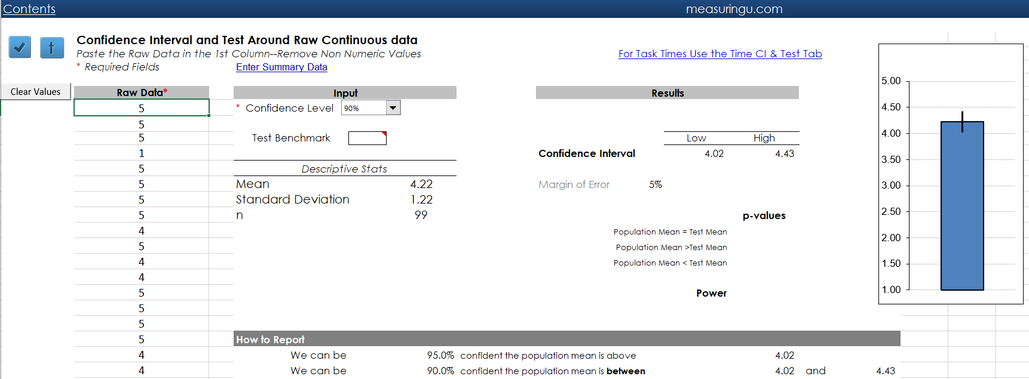
Confidence Interval Estimation: CSAT
Copy CSATnum data and paste into statsUsabilityPak - 1 sample t.
What is the plausible range? Is it significantly greater than 4?

Slide 90
T-TESTS
MeasuringU 2020

Slide 91
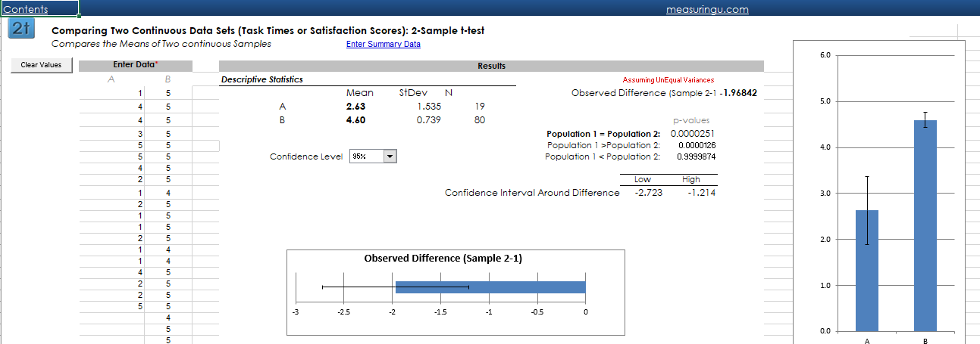
Between-subjects t-test: Task completion
Sort “Task accomplished?”; paste CSATnum in statsUsabilityPak - 2 sample t.
What is the mean difference? Is it statistically significant? Practically?

Slide 92
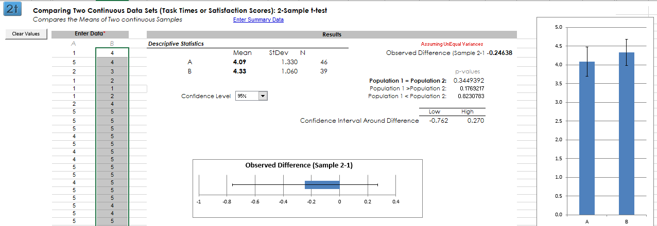
Between-subjects t-test: New vs repeat visit
Sort “NewVSRepeatVisit”; paste CSATnum in statsUsabilityPak - 2 sample t.
What is the mean difference? Is it statistically significant? Practically?

Slide 93
Within-subjects t-test: CSATper vs UXnum
Paste CSATper and UXnum into statsUsabilityPak - Paired t test.
What is the mean difference? Is it statistically significant? Practically?

Slide 94
CORRELATION
MeasuringU 2020

Slide 95
Correlation: CSATper with UXnum
Paste CSATper and UXnum into statsUsabilityPak - Regression
What is the correlation? Is it statistically significant? Practically?

Slide 96
2 PROPORTION TEST
MeasuringU 2020

Slide 97
2 Proportion Test: Booking vs Find Info successes
Paste # successes and totals into statsUsabilityPak - 2 comp rates.
What is the difference? Is it statistically significant? Practically?

Slide 98
ANALYSIS OF VARIANCE
MeasuringU 2020

Slide 99
ANOVA: Effect of fare on CSAT (between subjects)
Sort fares and copy CSAT values into statsUsabilityPak - ANOVA
What are the differences? Statistically significant? Practically?

Slide 100
ANOVA: Compare three ratings (within subjects)
Copy Simple, Engaging, and VisAppeal into statsUsabilityPak - RM-ANOVA.
What are the differences? Statistically significant? Practically?

Slide 101
MeasuringU.com
@MeasuringU
Remote UX Testing Platform
(Desktop & Mobile)
UX Research
Measurement
& Statistical Analysis
Eye Tracking &
Lab Based Testing
MeasuringU is a research firm based in Denver, Colorado focusing on quantifying the user experience.
UX Measurement Boot Camp

